Slide 1
A Fog and Blockchain Software Architecture for a Global Scale Vaccination Strategy.
H. J. De Moura Costa, C. A. Da Costa, R. Da Rosa Righi, R. S. Antunes, J. F. De Paz Santana and V. R. Q. Leithardt
Md. Iftekhar Hossain Turja
ID: 20301049
CSE449

Slide 2
Introduction
Challenges faced in healthcare include network latency, software scalability, health data privacy, and global patient identification.
Fog computing and blockchain technology have the potential to revolutionize global vaccination campaigns.
Fog-Care is a software architecture that addresses these challenges and supports a global vaccination campaign.

Slide 3
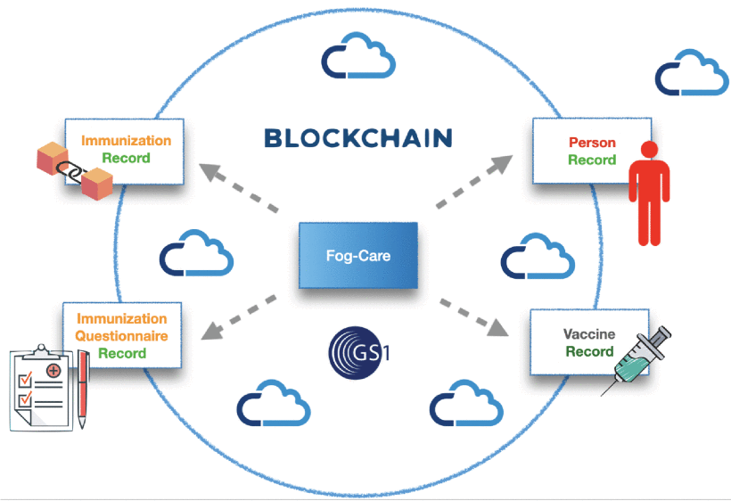
Objectives
Design
Evaluation
Design and Implementation of the Fog-Care Architecture.
Evaluating the system performance after implementation

Slide 4
Literature Review
Fog-Care and its benefits in global healthcare.
Related works in healthcare architecture lack a global unique identification system.
A global unique identification system is essential for effective data management and decision-making in a global environment.

Slide 5
Methodology
Integrating fog computing and blockchain technology with existing healthcare systems
Simulated a global vaccination campaign in Brazil, the USA, and the UK using virtual machines hosted on AWS.
Evaluated the performance of the architecture using metrics such as latency, throughput, and send rate.

Slide 6
Results
Architecture supports scalability with the addition of more fog nodes.
Average latency for transactions is less than one second.
High throughput and send rate indicate the efficiency of the system.

Slide 7
Conclusion
Fog-Care is a feasible and effective solution for a global vaccination strategy.
Provides fast and accurate decision-making in a dispersed and global environment.
Global unique identification system is essential for effective healthcare data management and decision-making.

Slide 8
Reference
De Moura Costa, H. J., Da Costa, C. A., Da Rosa Righi, R., Antunes, R. S., De Paz, J. F., & Leithardt, V. R. Q. (2022). A FOG and blockchain software architecture for a global scale vaccination strategy. IEEE Access, 10, 44290–44304. https://doi.org/10.1109/access.2022.3169418

Slide 9
Thank You!

